Slide 1

Guide to the
ECVS Board Examination

Slide 2
Introduction
The aim of the Exam Committee is to compile an exam that assesses whether candidates achieve the required minimum standard, as determined by the College, in order to be certified as ECVS Diplomates. Candidates should demonstrate a safe and logical approach to a broad range of cases in soft tissue surgery, orthopaedics and neurology.
The exam is not designed to catch you out, nor to expect you to demonstrate the same skill set as a Diplomate with many years of experience.

Slide 3
Overview
Resources
  Examination Guide
  Reading Lists
The ECVS Exam
  Case-based Exam
  Practical Exam
  Multiple Choice Questions Exam
Preparing for and sitting the
ECVS Exam
  Before the Exam
  Exam Technique
  Common Pitfalls
  Time Keeping
Marking and Pass Score Setting
  Case-based and Practical Exam
  MCQ Exam
Exam platform Q-examiner
Housekeeping
  Keyboards
  Unethical Behaviour
  During the Exam

Slide 4
Resources

Slide 5
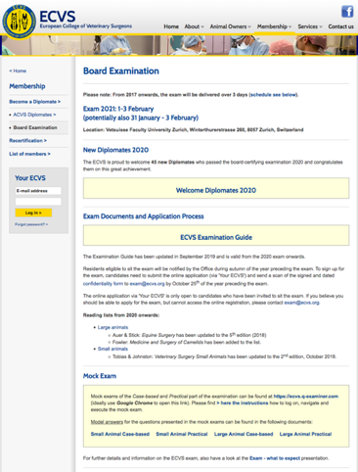
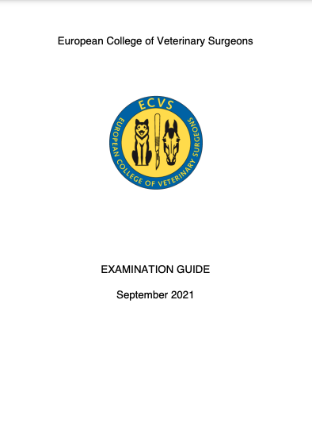
Examination Guide: read carefully!
current version
September 2022
https://www.ecvs.org/membership/board_examination.php
Notes:
Administrative details
timelline

Slide 6
Reading Lists
Two separate reading lists for SA and LA exam candidates
Reading list changes are communicated well in advance.
Be sure to consult the reading list valid for the exam (year) which you are planning to take.
Reading lists consist of
  main study text books
  text books recommended to revise basic knowledge
  further recommended text books which are considered useful sources, but not essential reading
  journals
https://www.ecvs.org/membership/board_examination.php#ReadingLists
Notes:
Administrative details
timelline

Slide 7
The ECVS Exam

Slide 8
Case Based Exam
AIM: To test whether a candidate can follow a case from start to finish, making sensible choices for the patient at each stage (prior to / during / after surgery).
FORMAT: 6 cases with 10 questions each (= 60 questions), delivered in 2 sessions
SA: 3 soft tissue cases, 3 orthopaedic cases. Neurology may be included.
LA: 3 soft tissue and 3 orthopaedic cases, of which 1 or 2 are food animal cases
Radiological images, laboratory findings and intra-operative photographs may be provided for your information.
Candidates are free to start the cases in their own preferred order. A case can be stopped at any time and returned to later. Candidates are responsible for their own time management!
NB: You can only see the next question in a case, not beyond that. To move through the case, a question needs to be answered and the answer saved in order to be able to move on. All answers are final once saved and cannot be edited later as new information will be given as the case progresses.
DURATION: Two 2-hour exam sessions, separated by a 30 minute break.

Slide 9
Practical Exam
AIM: To test interpretation and recognition skills
FORMAT: 20 scenarios with 3 questions each (= 60 questions), delivered in 2 sessions
occasionally, a scenario may have 2 or 4 questions, but the total remains 60
SA: 10 soft tissue, 10 orthopaedic including some neurology scenarios
LA: 7 orthopaedic, 4 alimentary, 3 respiratory, 3 urogenital, 1 special senses,
1 integument, 1 instrument of which 4 will be food animal scenarios
Videos, radiological images, intra-operative photographs or laboratory data may be provided to augment the scenario.
Candidates can navigate through the scenarios in one session entirely freely. All questions can be viewed from the beginning and started, stopped, returned to in any order at any time. Answers can be edited until the end of the session. Candidates are responsible for their own time management!
DURATION: Two 2-hour sessions with a short comfort break between

Slide 10
Multiple Choice Questions (MCQ) Exam
AIM: to assess knowledge of the relevant medical literature, both text books and journals (of the last 5 years)
FORMAT: 100 questions, each with a question stem and 4 answer choices (correct answer + 3 distractors)
10-20% of the questions are of a general nature (e.g. anatomy, physiology), the rest is species specific. The LA exam contains up to 20% food animal questions.
The order of the questions is randomised for each candidate.
The order of the answer choices is randomised for each candidate.
There is entirely free navigation throughout the exam. All questions can be viewed from the beginning. Answers can be edited until the end of the exam. Candidates are responsible for their own time management!
DURATION: One continuous 5-hour session. Candidates can leave when finished.

Slide 11
Preparing for and sitting the ECVS Exam
The following slides are meant as advice. There are no strict rules how to prepare for an exam. You will receive a lot of advice but what works for one person may not work for another.
Nothing can replace the interaction with your supervisor(s) and mentors!

Slide 12
Before the Exam
Start your preparation early. This is not an exam you can cram for.
Develop a regular study routine.
Make an accurate and achievable plan to cover the material that needs to be reviewed.
Maintaining good mental and physical health is invaluable when studying and should be part of the routine.
Remember for the case based and the practical, the questions are based on real-life cases rather than just book knowledge.
Practice mock questions

Slide 13
Before the Exam
Give yourself plenty of time to travel to the exam location and orient yourself in the city.
Allow plenty of time to get to the exam hall. The exam will start promptly and will not wait for you.
Guidance on what materials can be brought into the exam hall is detailed in the examination guide and in this presentation (Housekeeping).

Slide 14
Exam Technique
Take your time to read the question and think about what you are being asked - the time allocated for each exam session is designed to allow you more than enough time to answer the questions.
If the question asks you to BE SPECIFIC this usually relates to:
  using correct anatomical localisation (e.g. medial coronoid process rather than elbow, grade 3 left laryngeal hemiplegia rather than laryngeal hemiplegia or naming a specific axial pattern flap rather than saying skin flap)
  ensure you state the affected side e.g. LEFT or RIGHT
  using the correct and precise terminology, e.g. implants or a procedure
  detailing suture material or pattern, if the question requests this

Slide 15
Exam Technique
If a specific number of answers is requested, only that number of answers will be reviewed. If we ask for THREE items and you list more than three, only the first three will be marked, even if the correct answer appears further down the list.
Write your answers in a logical way:
  This will increase the likelihood of you delivering a correct answer.
  Do not simply write for the sake of writing.
  A list means a list – no explanation is required.
  Avoid the use of abbreviations, unless they are in very common use.

Slide 16
Exam Technique
Wherever possible, use generic names for drugs and sutures etc.
rather than trade names.
The language of the ECVS examination is English and thus you should answer in English. If you do not know the occasional precise word in English, you can write it in your native language, and we will do our best to understand your meaning.
A maximum number of characters is set for each answer. This number is indicated underneath the answer box. You can write more than the indicated maximum and your full answer will be visible to the Exam Committee, but the character count can significantly help you to judge whether a single term, a short sentence or a longer, essay-style answer is expected.

Slide 17
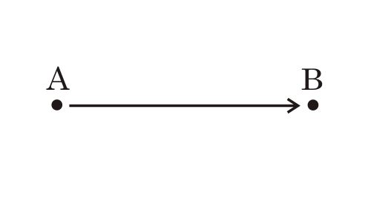
Common Pitfalls
List 4 modes of transport to travel from point A to point B
  - a blue car - a car
  - a yellow car - a bike
  - a red car - a bus
  - a purple car - a train
These are all the same mode of transport

Slide 18
Common Pitfalls
Question:
List THREE different causes of pyloric outflow obstruction in dogs.
- Adenocarcinoma - Neoplasia
- Leiomyoma - Foreign body
- Lymphoma - Muscular hypertrophy
(also accepted: mucosal
hyperplasia)
Note different causes
not different types
of neoplasia.

Slide 19
Common Pitfalls
Question: A 30kg dog presents with a history of progressive exercise intolerance and stridor. Direct laryngoscopy confirms bilateral paralysis of the arytenoid cartilages on inspiration. Radiography of the thorax and neck is unremarkable. Describe the FIVE main steps in the surgical management of this condition (excluding closure of the wound). BE SPECIFIC!
  Cut the skin, dissect thyropharyngeus, place stay suture on thyroid cartilage → NOT SPECIFIC
  Tying back laryngeal cartilages → TOO VAGUE
Think how you would describe the technique to a colleague over the phone!

Slide 20
  Correct answer:
  - Lateral approach to the lateral wing of the thyroid cartilage
  - Either spilt fibres of the thyropharyngeus muscle along its length
  OR cut the thyropharyngeus muscle
  - Transect cricoarytenoideus dorsalis muscle
  - Disarticulate the cricoarytenoid articulation
  (+/- cut the inter-arytenoid band)
  Preplace two cricoarytenoid sutures of 2/0 polypropylene
  (note appropriate size and type of suture OR one cricoarytenoid and one cricothyroid suture)

Slide 21
Time-Keeping
You are responsible for your own time keeping! Each of the questions carries the same number of points and although you may find some questions easier than others, you should not spend too much time on one question to the detriment of others.
Time calls will be made at set points through the examination and there will also be a clock visible on your lap-top screen.
You will not be allowed to leave the exam hall in the last 15 minutes of any examination session.

Slide 22
Marking and Pass Score Setting

Slide 23
How the Exam is marked:
Candidate identities are blinded to the examiners until after the marking process is entirely completed. Only candidate numbers are used to identify individuals.
For each part of the exam, the candidate will receive a PASS or FAIL result.
The case-Based and practical exams are marked using the PASS/BORDERLINE/FAIL method

Slide 24
Case-based and Practical Exam
In the first step, each candidate’s entire script for that part of the exam is independently reviewed by at least 3 examiners.
  Each examiner allocates each script a grade of either CLEAR PASS, BORDERLINE or CLEAR FAIL, depending on whether they feel the candidate does or does not meet the standards of the minimally qualified candidate (CLEAR PASS or CLEAR FAIL), or if they feel that no clear decision can be reached (BORDERLINE). Each examiner protocols the thoughts involved in the decision-making process on one sheet per candidate.
    This process takes in to account any decisions which have been made which could be considered dangerous for the patient.
  Once 3 examiners have reached the same grade for a script, this grade becomes the final grade for this candidate for this part. In this step, each script will be reviewed by at least 3 and up to 5 examiners.
    If 3 examiners do not agree on the grade, a 4th examiner will assess the script.
    If there still are no 3 matching grades, a 5th examiner will assess the script.
    If a decision is still not reached after assessment by all five examiners, the candidate will enter the borderline group.

Slide 25

Case-based and Practical Exam
Example:
Examiner 1 2 3 4 5

Slide 26
Case-based and Practical Exam
In the second step, all scripts in the BORDERLINE grouped are then marked numerically by 2 examiners independently.
  If the 2 examiners agree on the number of points to be given for an answer, the candidate’s answer get this many points.
  If the 2 examiners do not allocate the same points, these differences are discussed. Either the number of points are aligned following this discussion, or the examiners “agree to disagree”, in which case the candidate’s answer receives the average between these two scores.

Slide 27
Case-based and Practical Exam
All individual questions carry the same number of points (2 points per question).
There is no negative marking in the numerical marking. This means points are not deducted for a wrong answer.
Fractional scoring is in place for some questions. This means that you need to achieve at least half of the correct answers to an individual question in order to achieve any points.
Only full points are given (0, 1 or 2)
No half points are given.

Slide 28
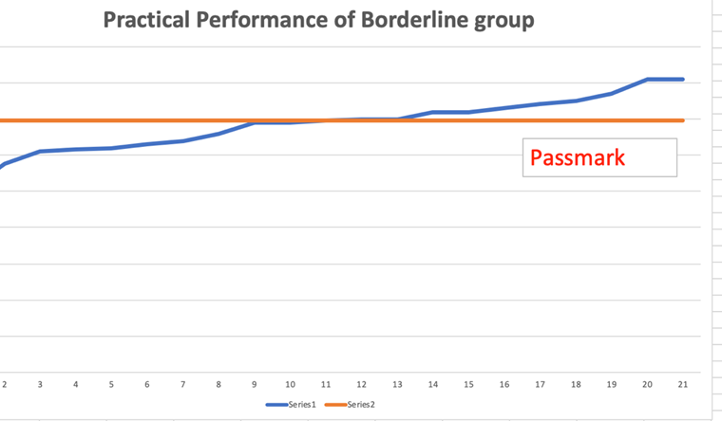
Case-based and Practical Exam
Finally, the median score of the BORDERLINE group is calculated and set as the final pass score.
  This means that 50% of the BORDERLINE group will pass and 50% will fail.
  For quality control purposes, several candidates from the CLEAR PASS and CLEAR FAIL groups are also numerically scored.

Slide 29
MCQ Exam
The Hofstee method is used to set the pass mark for the MCQ part of the exam:
The minimum and maximum failure rates for the examination are pre-determined, as well as what the minimum and maximum percentage pass mark score should be.
These rates and percent scores are projected onto the actual score distribution to derive a final pass mark.

Slide 30
Exam Platform Q-Examiner

Slide 31

Navigation – logging on
→ Enter your specific candidate number and click on Login

Slide 32
Navigation – logging on
For the mock exams available from the website, the password is ‘ECVS‘.

Slide 33
Navigation – logging on

Slide 34
Navigating the
Case-Based examination

Slide 35
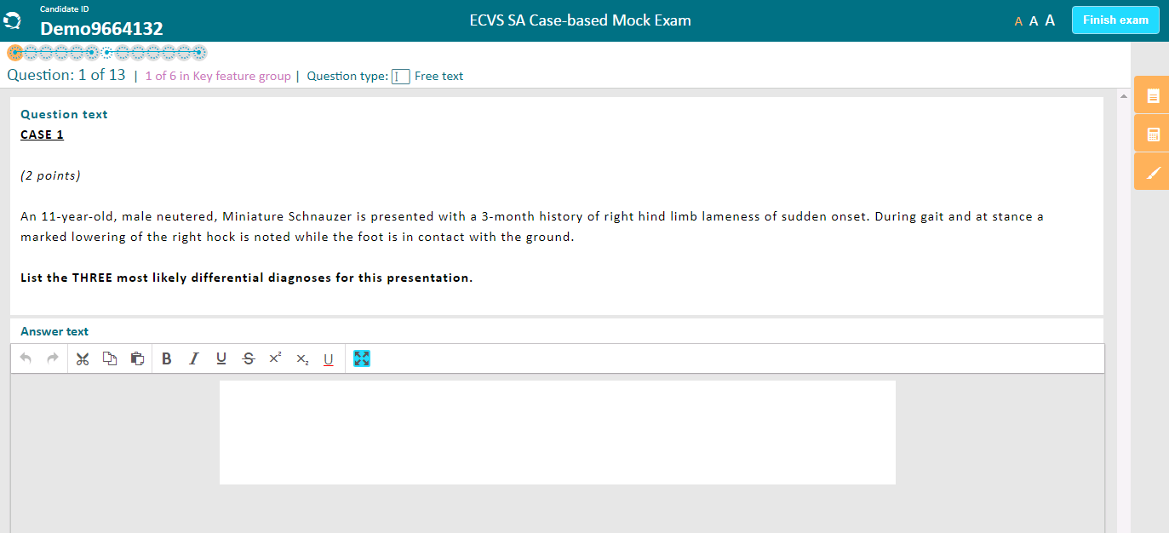
Tells you where you are in this particular case i.e. sub-question 1 of 13.
Tells you this is case 1 of 6, but you may start with whichever case you wish.
Write your answer here.

Slide 36
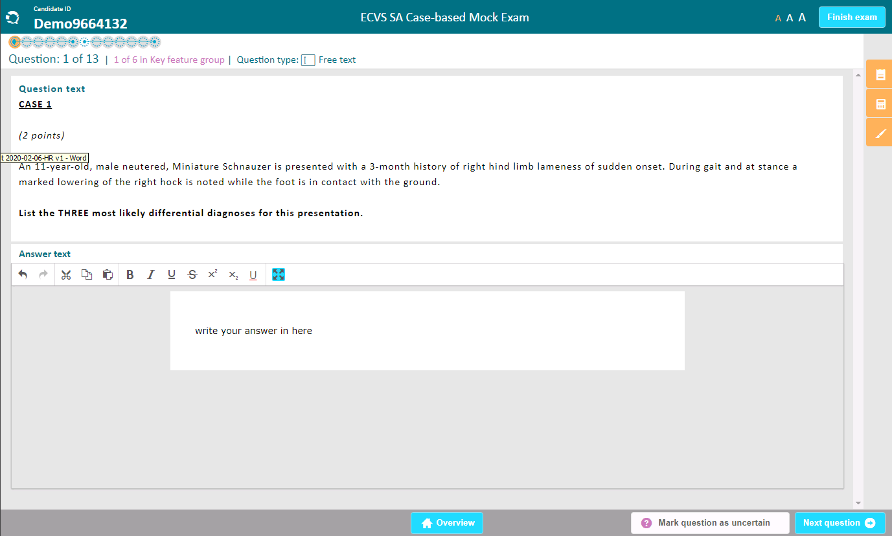
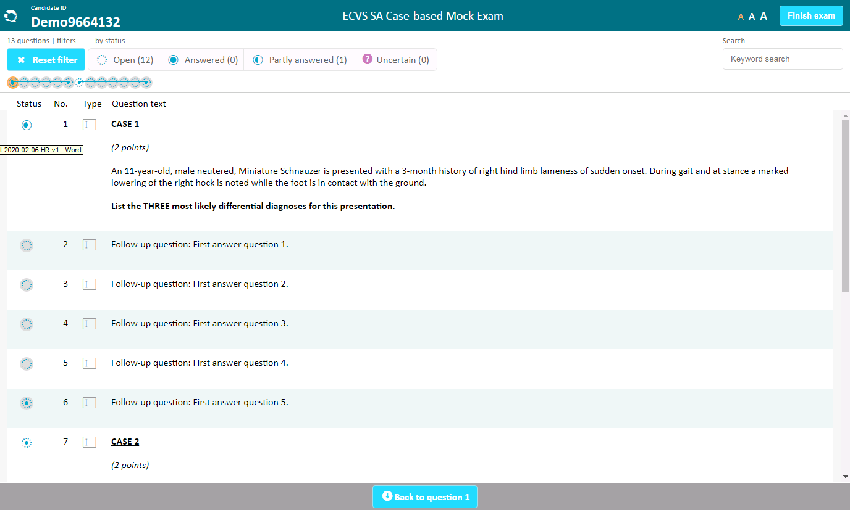
The overview button will take you to this screen where you can see where you are in the case or to pick a different case to start.
This same button takes you back to the question.

Slide 37
Only press once you have completely finished the WHOLE exam and are ready to leave.
These buttons are the notes section where you can write/draw rough notes or use the calculator.
This button will hide or re-show the question text if you wish.
This button leads to the next question. You cannot come back to edit your answer once you’ve moved to the next question!
In the case based exam if you mark a question as uncertain, you can start another case and come back, but you cannot proceed further with this case.

Slide 38
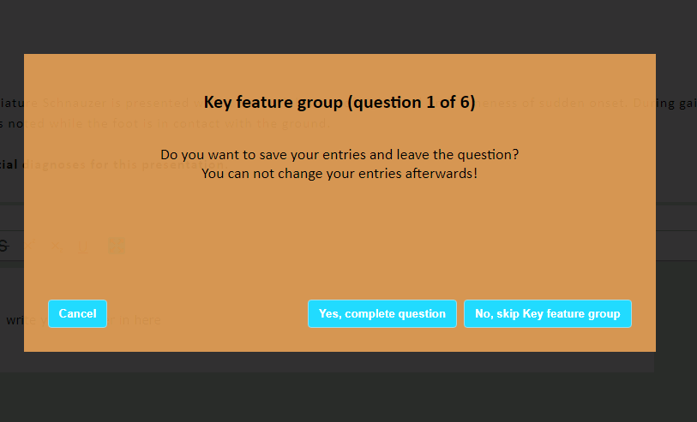
In the case-based exam, once you have clicked on the button “next question”, you will see this screen and can choose between:
return to the question to further edit it by pressing cancel
move to the next question (”complete question”)
move to start a new case (“skip Key Feature group button”)

Slide 39
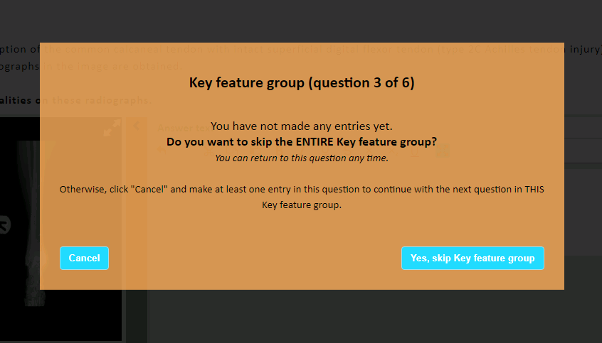
You must enter something in the textbox to be able to move to the next question within the case or you will see this screen. If you do not know the answer, you must enter some text (any) in the box to move forward.

Slide 40
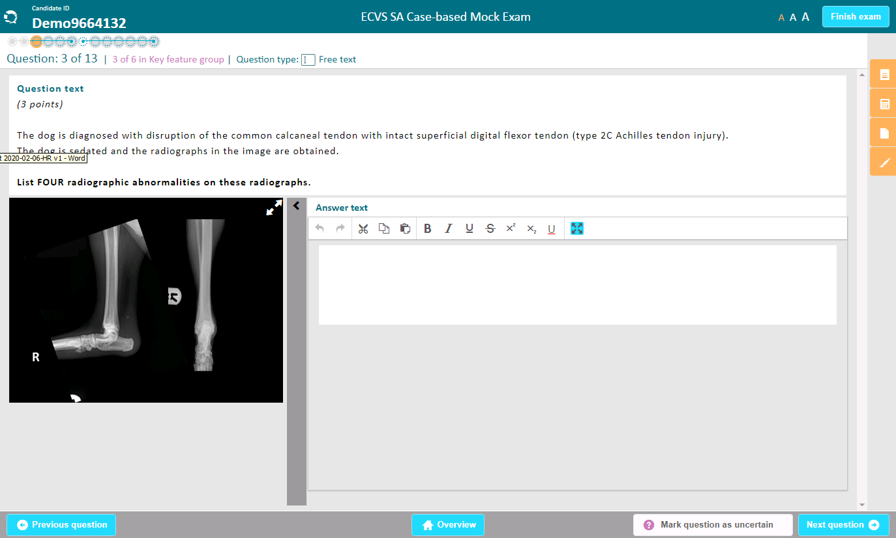
Some questions are associated with an image or a video, shown on the left side of the answer box.
Videos can be stopped anytime.
To enlarge or reduce the size of the image, click here.

Slide 41
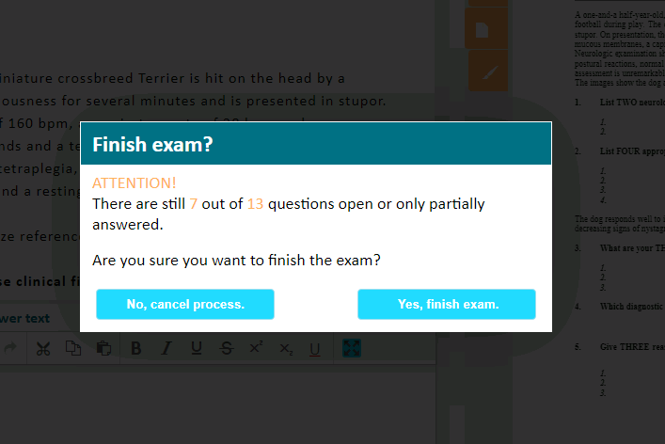
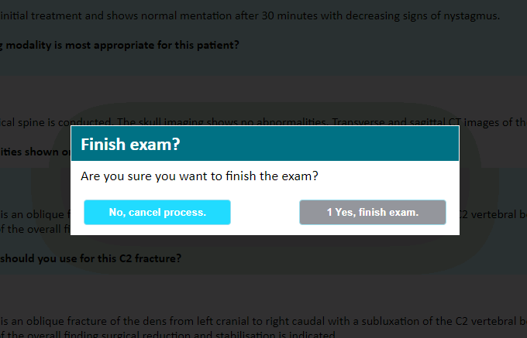
If you intend to finish the exam although some questions are still unanswered, you will see this screen.
If you press the finish exam button after all questions have been answered, you will see this screen.

Slide 42

Finally you will see this screen. Your exam paper is now complete and saved on the server.
At this point you may leave the exam room unless it’s within the last 15 minutes of the exam - in this case we ask you to remain seated to avoid disturbing other candidates.
Please logout when you are leaving the exam.

Slide 43
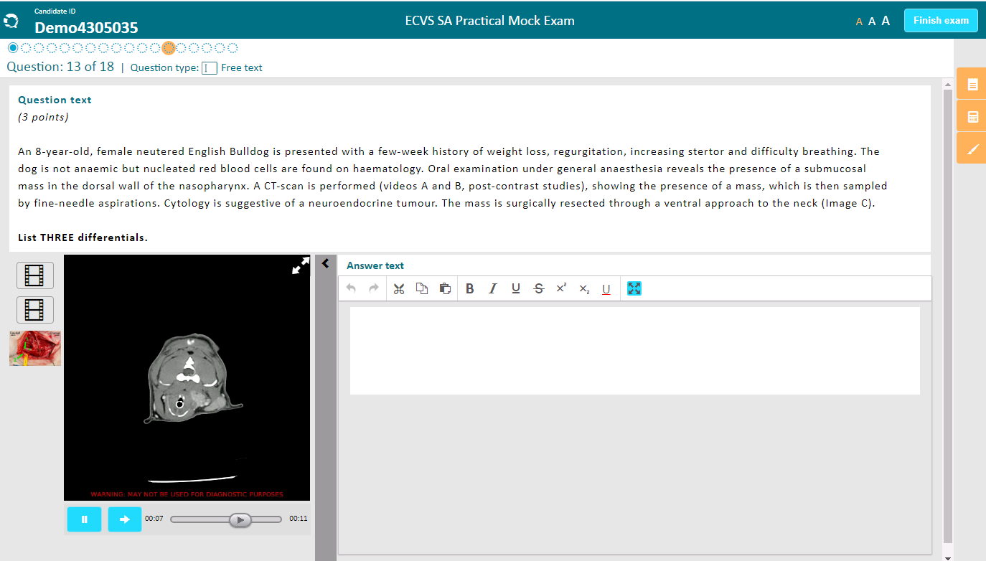
Differences in the Practical Examination
You can navigate between questions by clicking on the circles or via the overview feature. The filled in circle denotes which question you are currently answering.
Navigation on the Q-examiner platform is the same as for the Case-Based.
However, there is free navigation through the questions and you can answer them in any order.
You can get back and edit any question at any time before you press the “finish exam” button.

Slide 44
Housekeeping

Slide 45
Housekeeping: Keyboards
Computers will be set-up with a QWERTY keyboard (English) by default.
Candidates are not allowed to bring individual keyboards, but as far as possible ECVS will provide different language keyboards. The available choice will be communicated to the candidates in the registration form.
→ Candidates who prefer a different keyboard (other than QWERTY) need to indicate their choice when signing up for the exam.
Candidates cannot choose any keyboards other than those offered by ECVS, and there is no guarantee that keyboard orders received after the registration deadline can be accommodated.

Slide 46
Housekeeping: Unethical Behaviour
The ECVS Board and Examination Committees take any unethical behaviour very seriously.
Any suspicious behaviour, either before, during or after the exam could lead to suspension of that candidate from that examination or any subsequent examinations.
Candidates are spaced out over the exam room in order to prevent viewing of other screens, but please do not attempt to view other candidates’ screens.
Do not attempt to communicate with other candidates in any way during the examination.

Slide 47
Housekeeping: During the Exam
What to bring to the exam:
your candidate number
ear plugs (single ones, not to be connected by a cord etc.)
a language dictionary (which will be checked by an examiner prior the exam)
water (drinks and snacks will be provided)
pencils and paper will be provided (for your personal notes during the exam, these will not be marked and cannot be taken out of the exam hall)
a face mask (if required)

Slide 48
Housekeeping: During the Exam
What not to bring into the exam hall:
bags
coats
your mobile phone
iPads, smart watches and similar devices
your own keyboard
any head coverings or hats aside from those worn for religious reasons
any notes

Slide 49
Housekeeping: During the exam
If you need help with your computer, if you have a query about a question or need to go to the bathroom, please raise your hand and an invigilator will help you.
You may need to wait a few moments, if the invigilator is helping another candidate.
The technical team who are responsible for the computer hardware will be present during the examination to deal with any computer issues.
You can leave the exam hall when you have finished the exam but not during the final 15 minutes of each session. You need to sign out when you leave the exam hall at the end of a session.

Slide 50
Summary

Slide 51

Summary
You will have worked hard during your residency to prepare for this exam: so try to stay calm and do not panic!
Do take the opportunity to visit the mock examination (accessed from the ECVS website) to familiarise yourself with the format and type of questions and the Q-examiner platform!
Read the questions thoroughly and think about what you are being asked for.
The Exam Committees and the ECVS office are here to help, but please do give us as much notice as possible, if you need assistance.
We wish you the very best of luck for your exam!

