Slide 1
Report from the Credentials Committee
Markus Wilke
Chair Credentials Committee

Slide 2
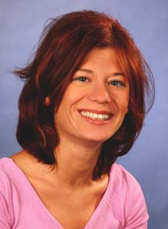
Who we are: CC Members
Large Animal
Sigrid Grulke
Karsten Velde
Markus Wilke
Small Animal
Ross Doust
Eithne Comerford
Daniela Murgia
Sébastien Etchepareborde

Slide 3
Who we are: Programme Recertification Committee
Large Animal
David Bolt
Small Animal
Jean-Philippe Billet

Slide 4
Who we are: Credentials Secretary
Eva-Linda Skytting

Slide 5
Where to find information:
Supervisor / Programme Director
Senior Residents
credentials@ecvs.org

Slide 6
Communication
ECVS office
CC
credentials@ecvs.org

Slide 7
CC Meetings & Deadlines
CC meets regularly in September, February and July
Items to be considered: 15th of the month prior to each meeting
 | September | February | July
ACVS→ECVS | 15th August | 15th January | 15th June
New Applications | 15th August | 15th January | 15th June
New Programmes | 15th August | 15th January | 15th June
Programme Changes | 15th August | 15th January | 15th June
Other/Special items | 15th August | 15th January | 15th June
Annual Reports | 31st July
Credentials | 15th August

Slide 8
Credentials Application
15
Logging stops on 31st July - you have until 15th August to send your credentials to the office
AUGUST

Slide 9
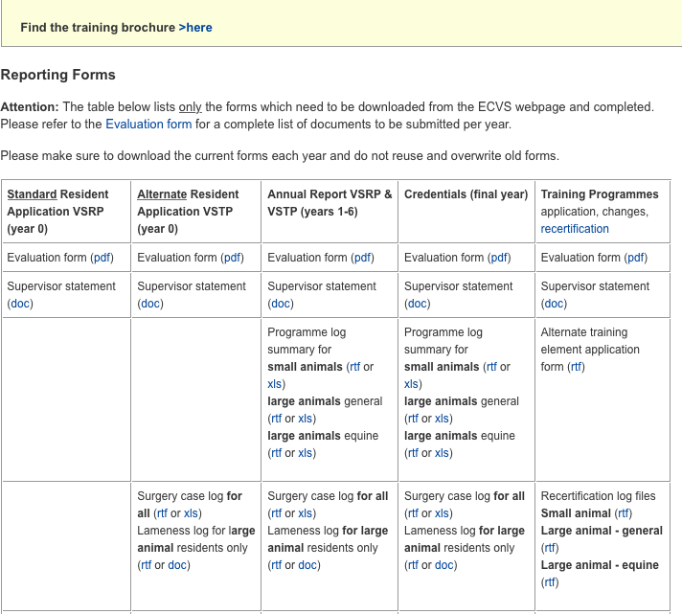
Common mistakes in Annual Reports
General
Surgery Log
Changing format of the forms
Upload of scans rather than original .pdf files
Listing of minor or non-surgical procedures
Coding errors
Limited procedures not numbered
Use of inappropriate scientific language
Activity Log
Performing elective surgery during other rotations
Need to list activity week by week – blocks of weeks OK
Log Summary
Cumulative case numbers do not match or not entered at all

Slide 10
ECVS Evaluation Platform
Replace the current Reporting and Credentials platforms
Web access via Your ECVS
Eliminate high number of formal mistakes
Save time: Residents - Supervisors - CC
Allow statistical analysis of data: Percentage and diversity of specialist procedures Total Programme case load over the years Allow suggestions for external rotations and/or CE courses Correlate Training Situation with Performance in Board Exam

Slide 11
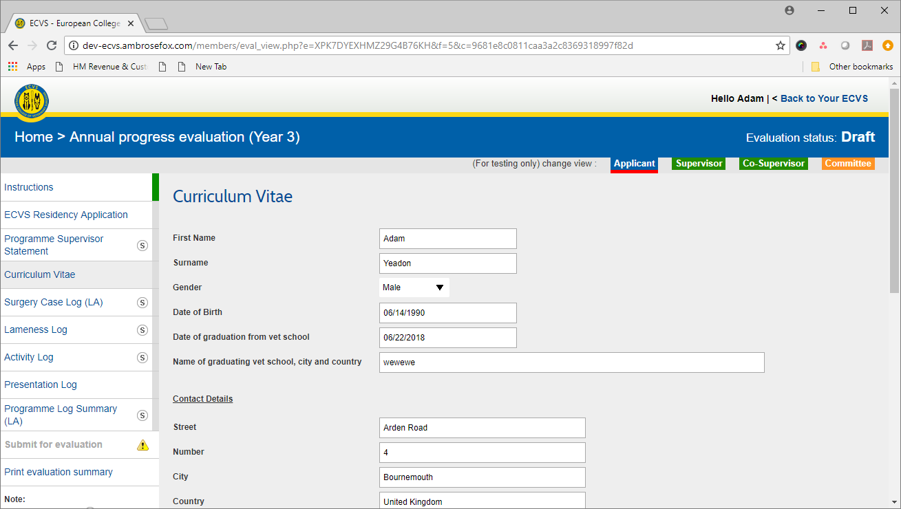
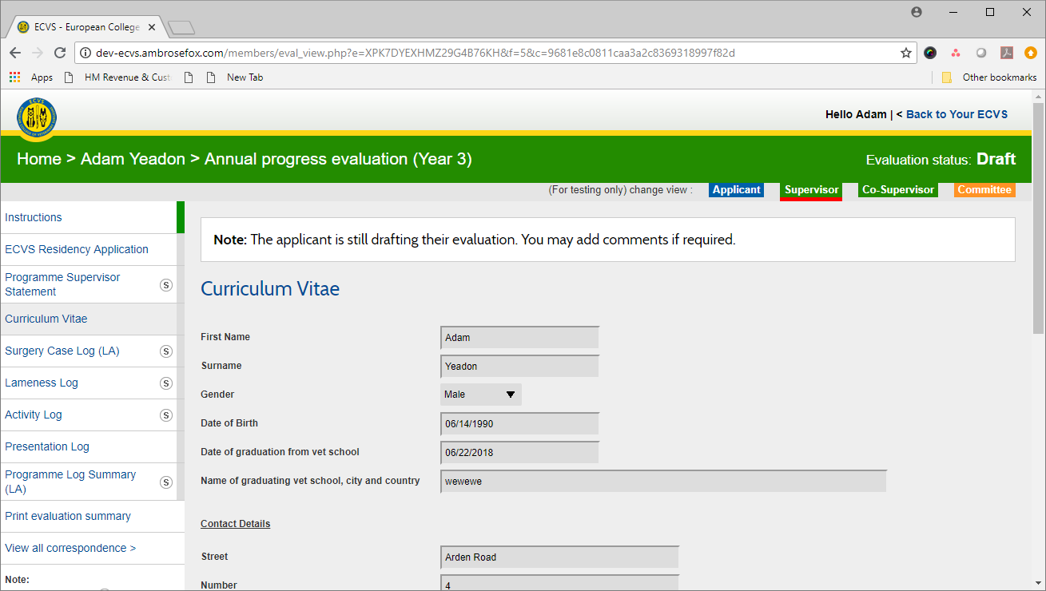
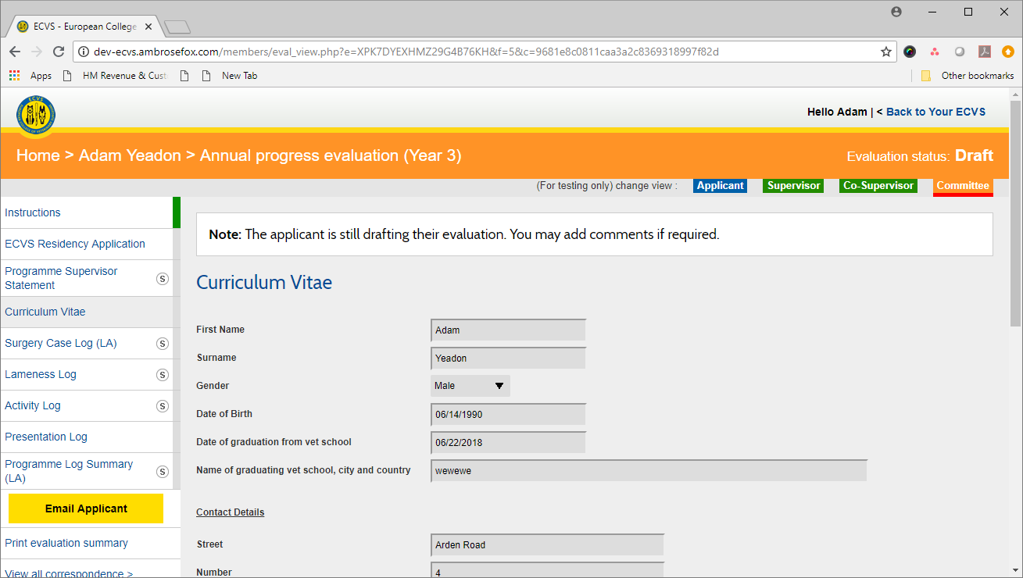
Resident, Supervisor and Committee access
Resident enters information over time
Supervisor approves content
Committee member accepts/rejects

Slide 12
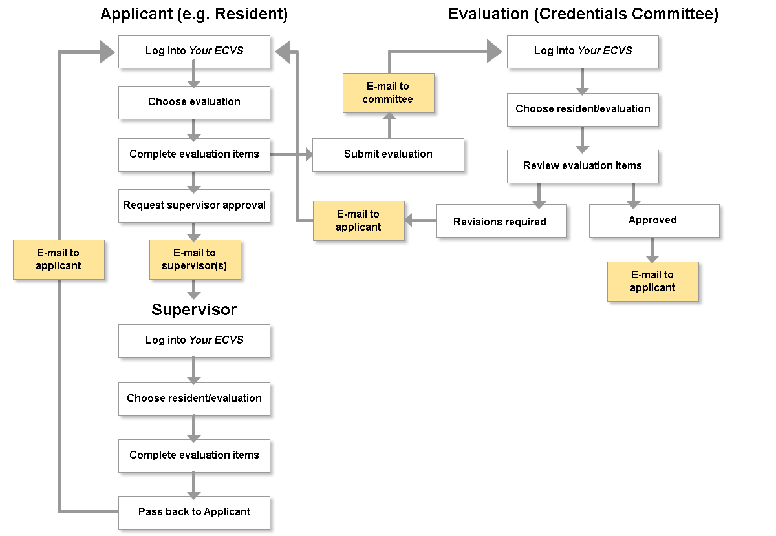
Evaluation workflow

Slide 13
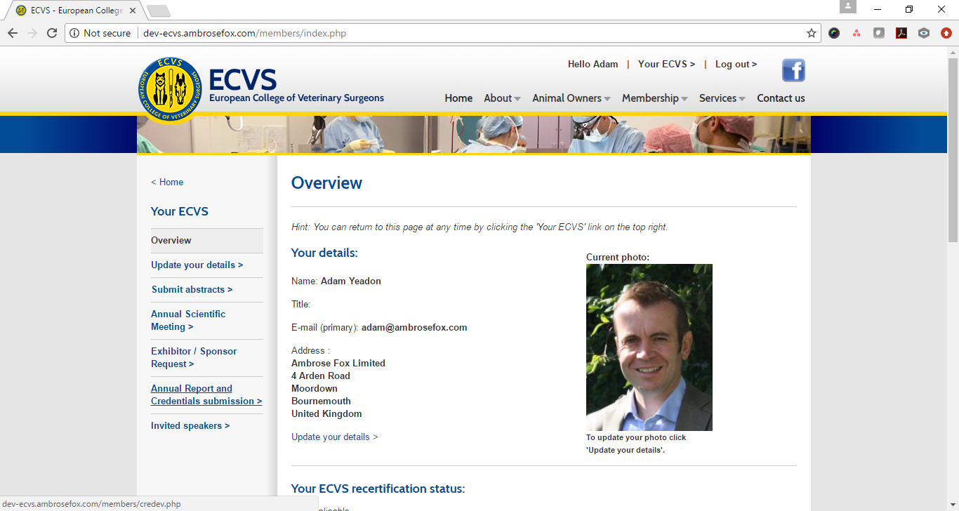
Notes:
Accessed via Your ECVS

Slide 14
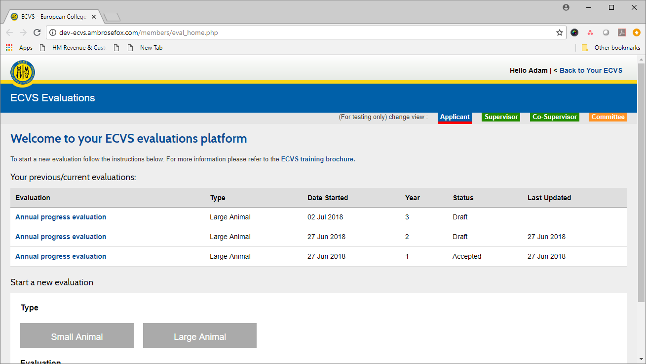
Notes:
Home page with access to current and previous evaluations

Slide 15
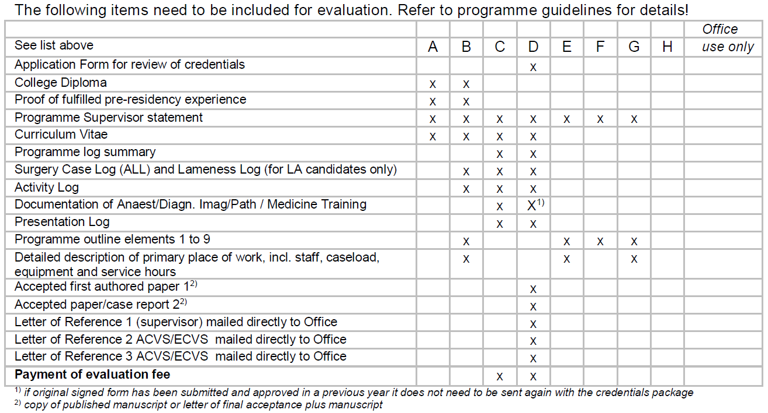
7 different types of evaluation (A-G)
Each evaluation consists of
multiple items

Slide 16
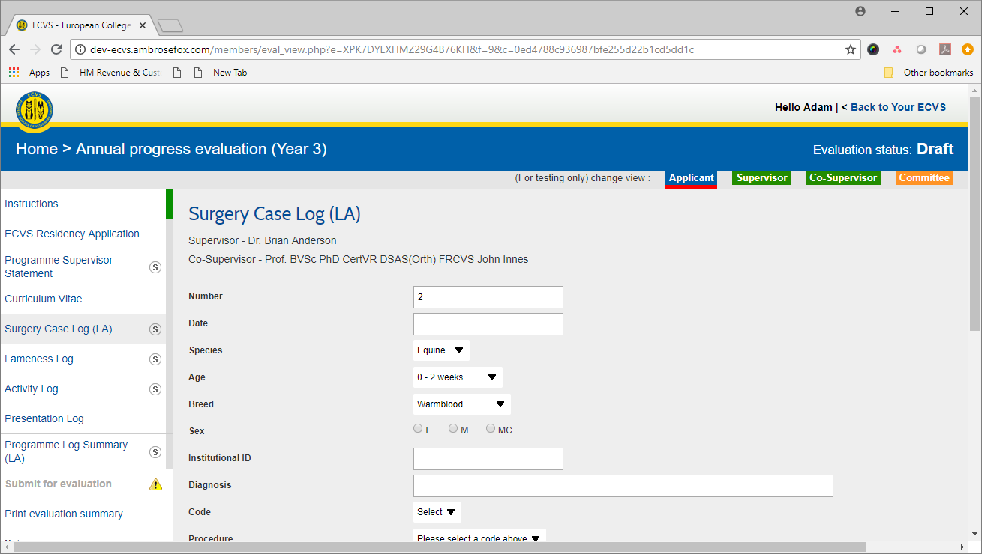

Slide 17
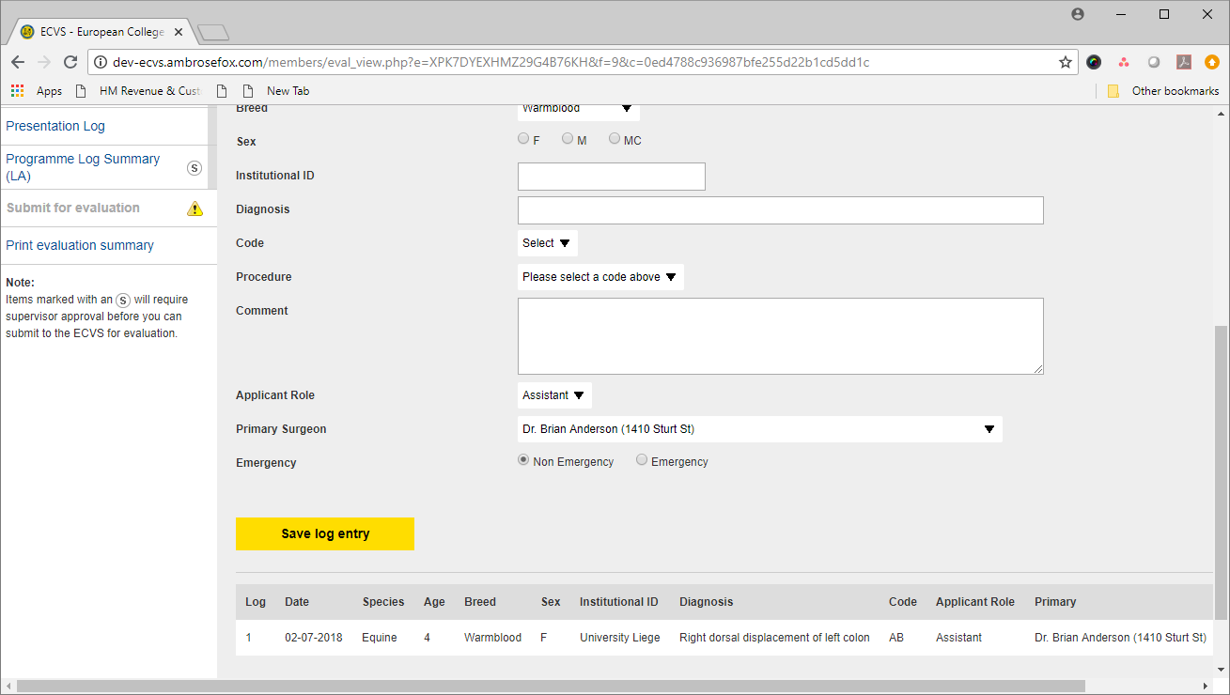

Slide 18
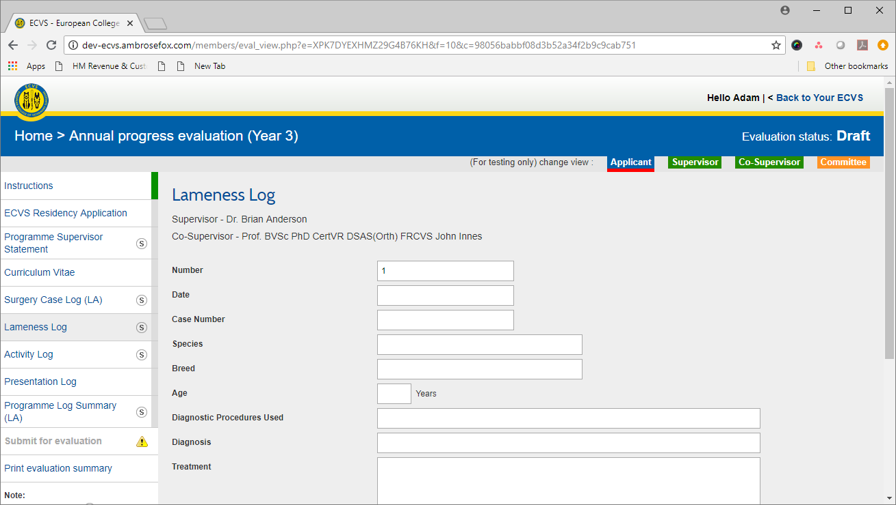
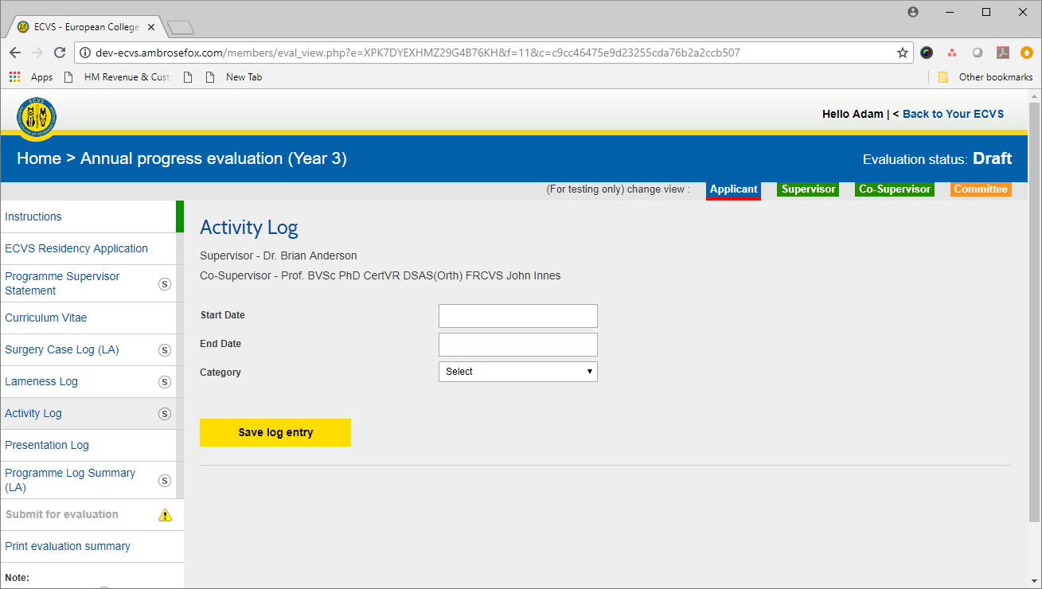

Slide 19
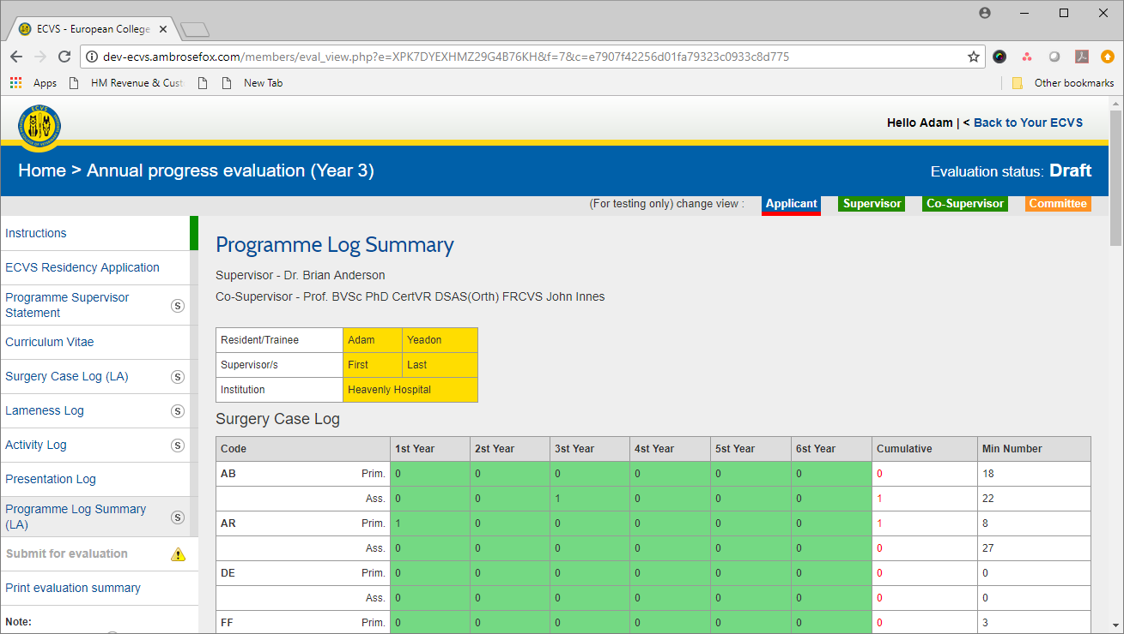

Slide 20
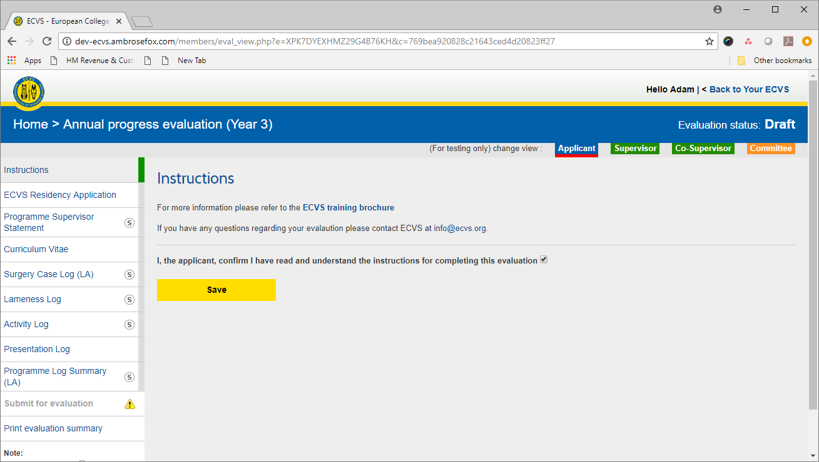

Slide 21
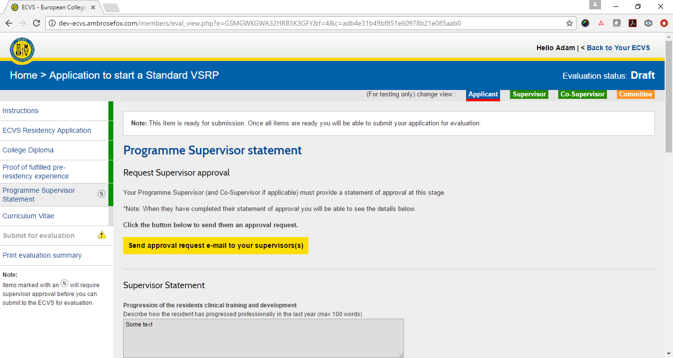

Slide 22
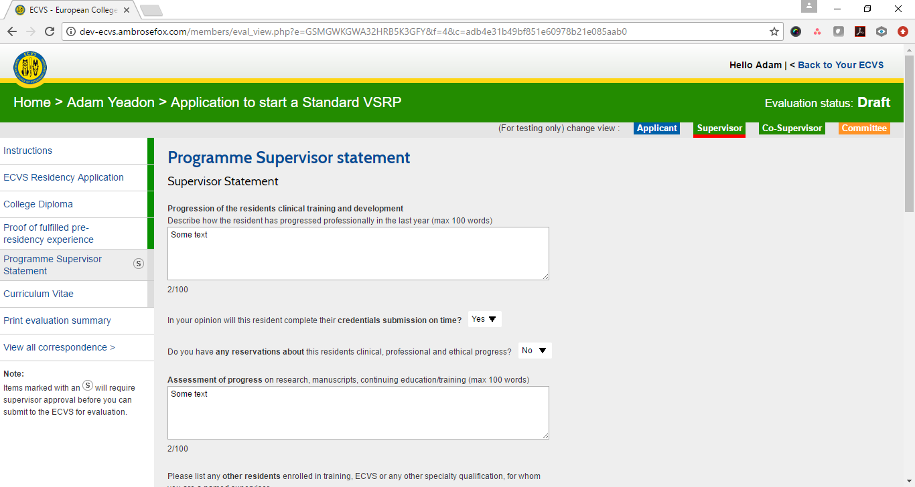

Slide 23
ECVS Evaluation Platform Launch:
Beta-version to be tested with a group of Residents/Supervisors (July to September)
Evaluate of test phase and fix bugs
Possible launch of new system from September onwards initially (for LA Residents)
Old system will stay in place for upcoming reporting period

Slide 24
Thank you for your attention – Any questions?

